Slide 1
Career Exploration
Digital Lesson Bundle

Slide 2
Turn and Talk
What are 21st Century Skills?
What are examples of 21st Century Skills?
What are the 4Cs?
Why are the 4Cs important?
Notes:
Instructor Notes
Before students get started on the career exploration project, review what they learned in the module about 21st Century Skills and the 4Cs.
Note: If your students did not complete the Preparing for a Professional Internship self-paced module, use the 21st Century Skills Summary handout to provide them with an understanding of the concepts before moving on to Slide 2.
Explain to students that as you reveal each question, they should turn to the person sitting next to them and discuss it for about a minute.
Click to display the first question, “What are 21st Century Skills?” After approximately one minute, ask for 1–2 volunteers to share what they remember from the module. Correct any misconceptions as they occur.
Click to do the same for each of questions 2–4.

Slide 3
Pathway to the Future
I need to go to college to get a good job.
Trade school is as valuable as college.
Internships aren’t useful for people who want to work in manufacturing.
My grades are a good predictor of my future success.
Notes:
Instructor Notes
Remind students that recognizing and practicing these skills now can help them prepare for a professional internship, and a successful internship can be the first step in a successful career, but that it isn’t the only first step. Reinforce that there isn’t one right way to enter into the career force.
Ask students to consider for a moment how they could best ensure their own future success. As you reveal each statement on the slide, instruct them to hold a thumbs up in the air if they agree with the statement or a thumbs down if they disagree.
Note: This is not intended to be an official poll, and there is no need to keep track of responses. The purpose of the exercise is to encourage students to reflect on their own attitudes and beliefs.
Click to display the first statement, “I need to go to college to get a good job.” Give students the opportunity to hold up a thumbs up or thumbs down before moving on to the next statement.
Click to do the same for each of statements 2–4.
Let students know that they will be researching different careers during this exploration activity, and it will be important for them to note the different requirements for entering into each one.

Slide 4
Collaborative Teams
Effective collaboration with your peers can lead to better problem solving, increased productivity, flexibility, and more successful communication.
Notes:
Instructor Notes
Explain that an acronym is used in the industry to describe environments and spaces: IEQ or Indoor Environmental Quality.
To achieve a high IEQ and be considered a “healthy space,” it must be good for people and the planet.

Slide 5
Career Exploration Road Map
Notes:
Instructor Notes
Distribute one Career Exploration Roadmap student handout and one Career Exploration Table student handout to each group. Remind students that throughout this project, starting with their roadmaps, they will have to work collaboratively, figuring out how to make sure every person in the group is heard and respected while coming to decisions that are most efficient and beneficial for the group. Emphasize that this might not mean every person always gets what they want but that every point of view is considered in the process of coming to a decision that is best for the entire team.
Students will complete the roadmap flowchart using the accompanying table in order to determine which career their group will research. They will begin by discussing within their teams which of the 4Cs they believe to be most important in a successful career.
Note: If your students did not complete the Preparing for a Professional Internship self-paced module, use page 2 of the 21st Century Skills Summary handout to provide them with an understanding of each of the 4Cs before beginning the roadmap.

Slide 6
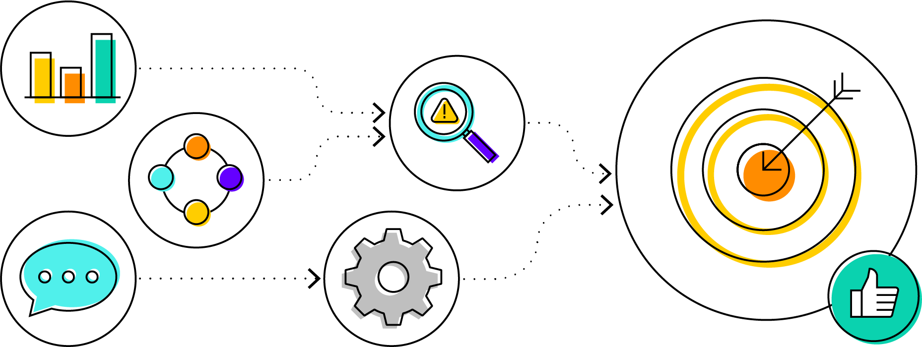
Career Selection
Choose a 4C
Degree or No Degree
STEM or Literacy
Choose a Career
Notes:
Instructor Notes
Click to reveal the first step, “choose a 4C.” Instruct students to circle their 4C of focus, based on their group’s discussion. They should fold their exploration table along the dotted lines so that only the relevant box is visible.
Click a second time. Groups will then decide whether they are interested in researching professional careers that require college degrees or those that do not require a bachelor's degree or higher. Remind students that just because a career does not require a degree does not mean that there are not educational or training requirements. They should put an X through the box in the table they did not choose.
Click again. Groups should work together to decide if they are interested in careers that have a STEM focus or careers that rely more heavily on literacy skills and the humanities. They should cross out the careers they will not be pursuing.
Click a final time. Provide groups with approximately five minutes to discuss the careers that remain as options in their tables. Each member of the group should weigh in on their thoughts regarding which career the group should research, remembering that they will be responsible for communicating their research to their peers. Once students have made their final decision, they should circle the career they have chosen.

Slide 7
Task Delegation
Project Manager
Online Researcher
Recorder
Presentation Lead
Notes:
Instructor Notes
Emphasize that an important part of collaboration is recognizing the unique strengths of each member of a team and delegating tasks so that each person’s talents are being utilized effectively.
Distribute a Project Outline student handout to each group and review with the class. Provide some characteristics that might be associated with each role, such as:
Project Manager: strong leadership skills; perseverant; punctual; good verbal communication skills
Online Researcher: technologically savvy; discerning and critical; observant
Recorder: good written communication skills; detail-oriented
Presentation Lead: outgoing; creative; innovative
Give them the rest of the session to discuss their strengths and challenges and determine who will be assigned each job listed in the project outline. They should write the assignments down.
Students should review the task list before the session ends. There is a space for project notes, so groups can keep track of the decisions they make and thoughts that come up along the way. Remind students to bring the handout back to the next session.

Slide 8
Communicating Your Research
Notes:
Instructor Notes
Briefly review what was covered in the first session. Emphasize that the 4C communication is not only important within their cooperative groups to effectively research their career, but it will also be vital that they demonstrate strong communication skills while presenting their research to their peers.
Remind students that communication is both the sharing of information in different ways and also understanding the information that is shared by others.
Provide an opportunity for students to brainstorm presentation methods or ways to communicate their research findings to their peers. You may also consider providing students with options from which they can choose. As time and space allow, the following non-exhaustive list may be used:
Use of presentation software such as PowerPoint or Google Slides
Video presentation
Social media story
Gallery walks
Poster, pamphlet, or binder
Website creation
Blog post
Infographic

Slide 9
Ready… Set…
Task
Identify reliable online sources for research
Record research findings
Determine presentation method
Assign presentation roles
Organize information presentation
Create necessary visuals
Facilitate rehearsal/ensure preparedness
Communicate research to peers
Career Element
Job Description
Education/Training Requirements
Career Pathway
Expected Salary
What Do They Do?
Where Do They Work?
Important Qualities
Similar Jobs
Notes:
Instructor Notes
Once groups have decided upon their presentation method, review the task list and the required career elements on the Project Outline student handout. Based on their assigned jobs, students should further assign each task.
Point out to students the “group reflection” section at the end of the handout. Encourage them to set aside time to discuss why they are interested in their chosen careers and communicate that in some way as part of their presentations.
Groups should use the remainder of the session to research their careers, record their information, plan their presentations, and create any needed materials.

Slide 10
Present!
Notes:
Instructor Notes
Determine the class time needed and the space available to provide each group with the opportunity to present their research in their chosen method. As there are many potential presentation methods, this might take the form of additional class time, various publication methods, community or whole-school events, interviews, etc. Suggestions are provided in the Extensions for Educators section for how to extend this activity into a longer-term project.

Slide 11
Take Time to Reflect
How did you use the 4Cs?
Did you learn about a career that interests you?
What do you think is the key takeaway?
Notes:
Instructor Notes
Distribute a copy of the Career Exploration Reflection student handout to each student.
Click to reveal the first question. Provide time for students to respond on their handouts.
Click again to show the second question. Again, provide time for students to respond on their handouts.
Click a third time to reveal the final question. Allow students to complete their reflection handouts.
As time allows, provide students with the opportunity to share their responses or facilitate a whole-group discussion on the reflection questions.

